Slide 1
Stanford CS223B Computer Vision, Winter 2005
Lecture 16:
Recognition
Sebastian Thrun, Stanford
Rick Szeliski, Microsoft
Hendrik Dahlkamp and Dan Morris, Stanford
[slide credit: Alexander Roth and Kevin Murphy]

Slide 2
Eigenfaces, the algorithm
Assumptions
  Square images with W=H=N
  M is the number of images in the database
  P is the number of persons in the database
[slide credit: Alexander Roth]

Slide 3
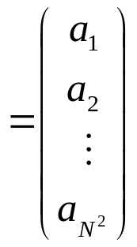
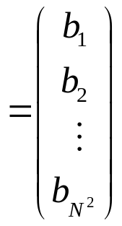
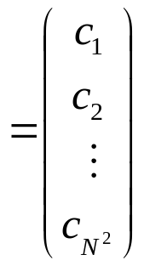
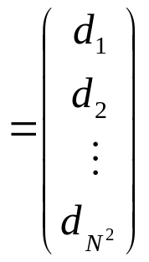
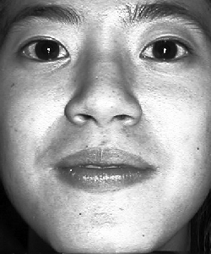
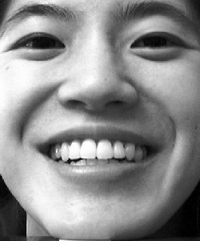
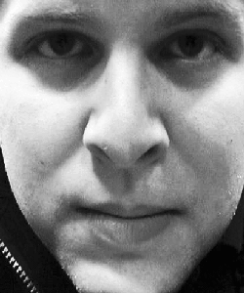
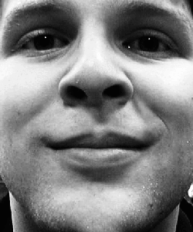
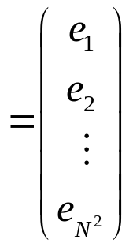
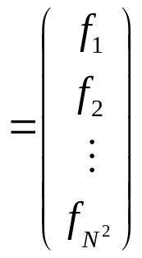
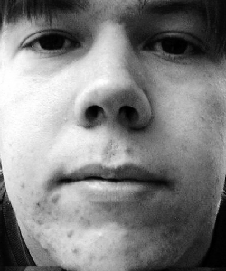
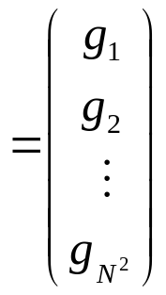
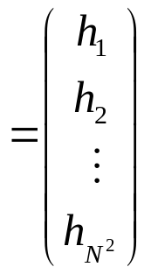
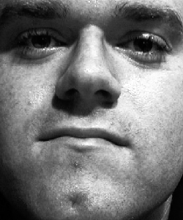
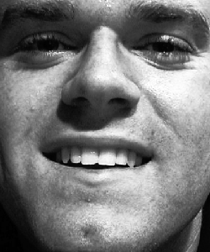
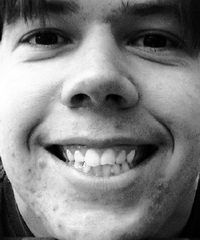
Eigenfaces, the algorithm
The database
[slide credit: Alexander Roth]

Slide 4
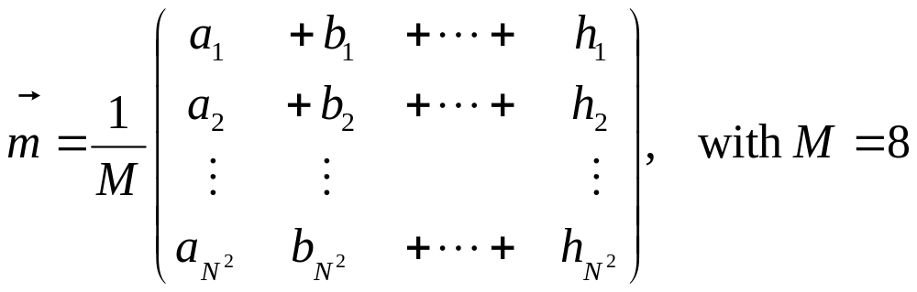
Eigenfaces, the algorithm
We compute the average face
[slide credit: Alexander Roth]

Slide 5
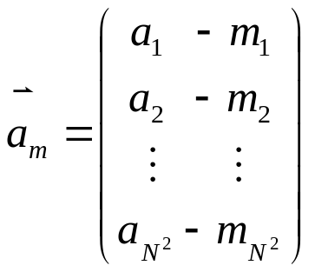
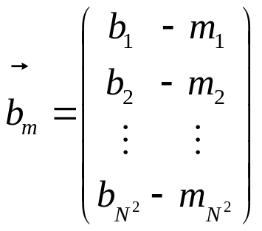
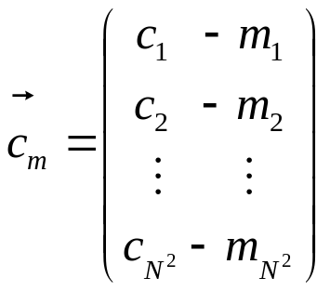
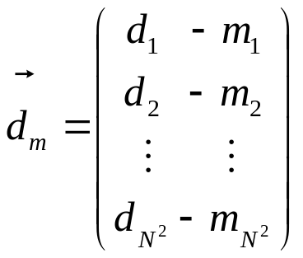
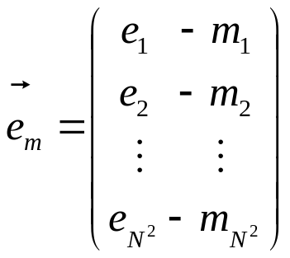
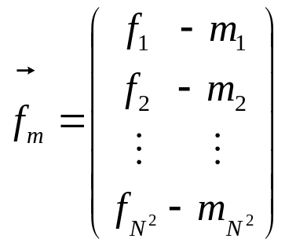
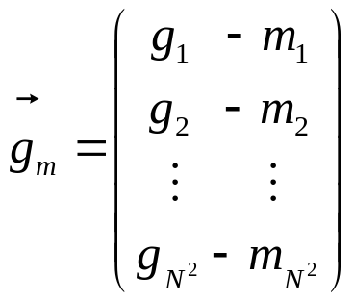
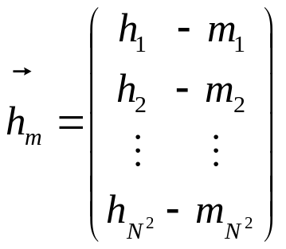
Eigenfaces, the algorithm
Then subtract it from the training faces
[slide credit: Alexander Roth]

Slide 6
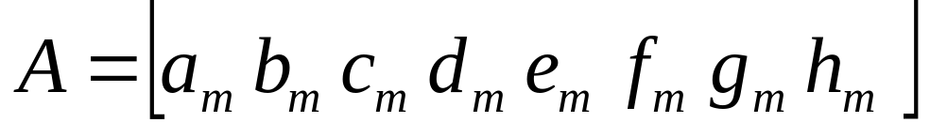
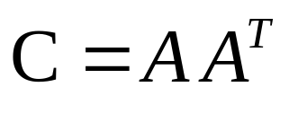
Eigenfaces, the algorithm
Now we build the matrix which is N² by M
The covariance matrix which is N² by N²
[slide credit: Alexander Roth]

Slide 7
Eigenfaces, the algorithm
Find eigenvalues of the covariance matrix
  The matrix is very large
  The computational effort is very big
We are interested in at most M eigenvalues
  We can reduce the dimension of the matrix
[slide credit: Alexander Roth]

Slide 8
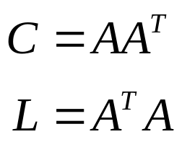






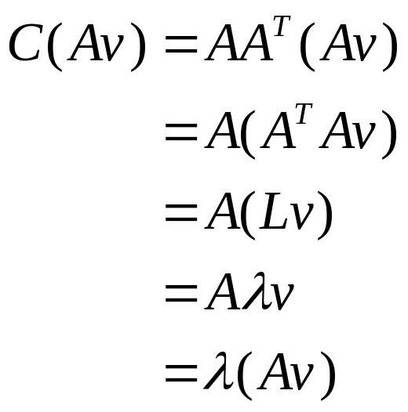
Eigenvalue Theorem
Define
  dimension N² by N²
  dimension M by M (e.g., 8 by 8)
Let be an eigenvector of :
Then is eigenvector of :
Proof:
[slide credit: Alexander Roth]

Slide 9
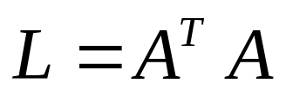
Eigenfaces, the algorithm
Compute another matrix which is M by M
Find the M eigenvalues and eigenvectors
  Eigenvectors of C and L are equivalent
Build matrix V from the eigenvectors of L
[slide credit: Alexander Roth]

Slide 10
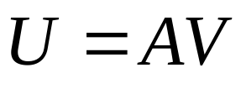
Eigenfaces, the algorithm
Eigenvectors of C are linear combination of image space with the eigenvectors of L
Eigenvectors represent the variation in the faces
[slide credit: Alexander Roth]

Slide 11
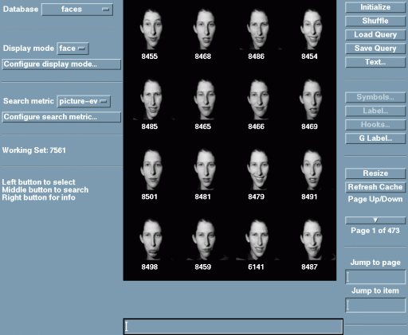
Example Set
Photobook, MIT

Slide 12
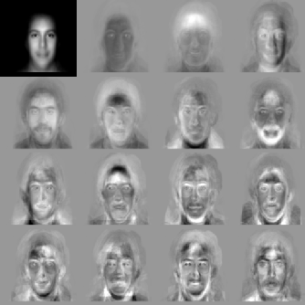
Eigenfaces

Slide 13

Normalized Eigenfaces
[Note: sharper]

Slide 14
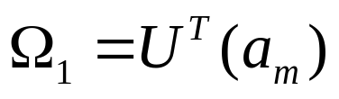
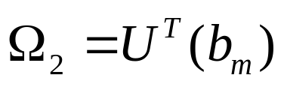
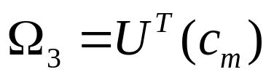
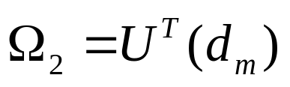
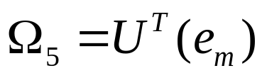
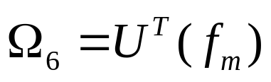
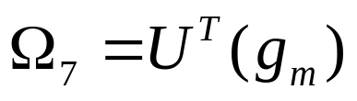
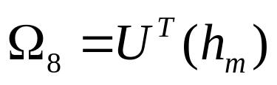
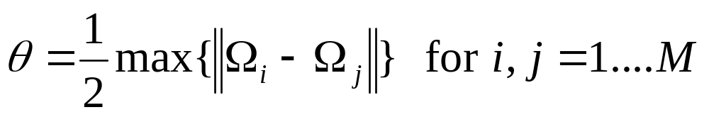
Eigenfaces, the algorithm
Compute for each face its projection onto the face space
Compute the between-class threshold
[slide credit: Alexander Roth]

Slide 15
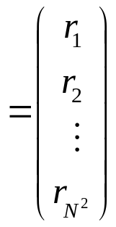
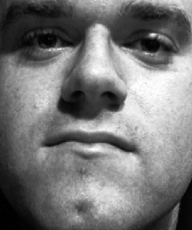
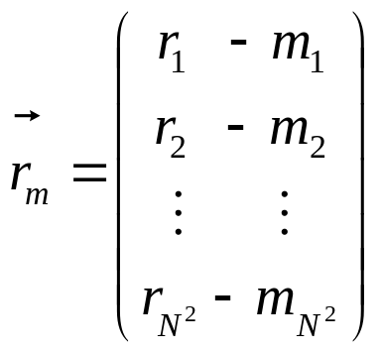
Eigenfaces, the algorithm
To recognize a face
Subtract the average face from it
[slide credit: Alexander Roth]

Slide 16
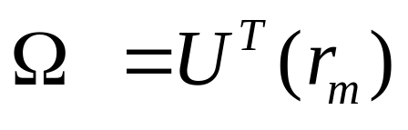
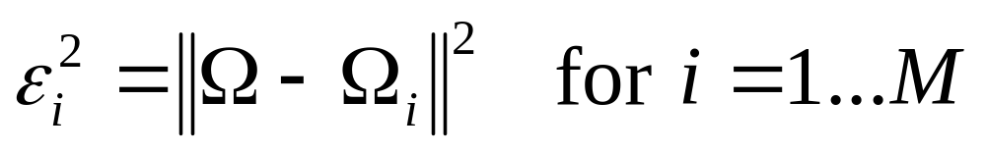
Eigenfaces, the algorithm
Compute its projection onto the face space
Compute the distance in the face space between the face and all known faces
[slide credit: Alexander Roth]

Slide 17
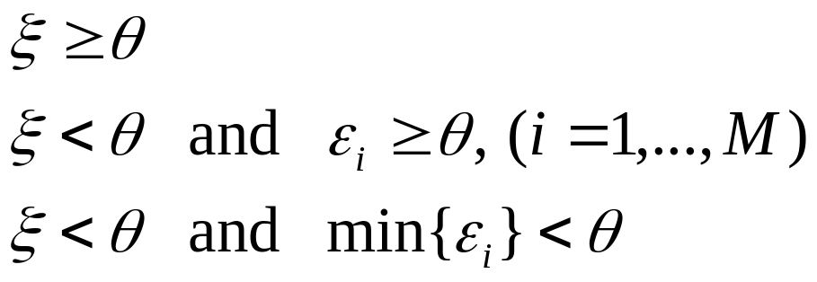
Eigenfaces, the algorithm
Distinguish between
  If it’s not a face
  If it’s a new face
  If it’s a known face
[slide credit: Alexander Roth]

Slide 18
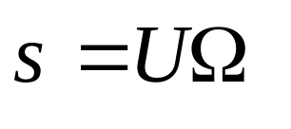
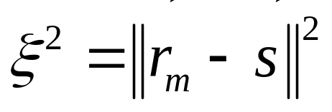
Eigenfaces, the algorithm
Reconstruct the face from eigenfaces
Compute the distance between the face and its reconstruction
[slide credit: Alexander Roth]

Slide 19


Eigenface Reconstruction
q=1
q=2
q=4
q=8
Original Image
q=16
q=32
q=64
q=100

Slide 20

More Eigenfaces

Slide 21
Eigenfaces, the algorithm
Problems with eigenfaces
  Different illumination
  Different head pose
  Different alignment
  Different facial expression
[slide credit: Alexander Roth]

Slide 22
Summary Object Detection/Recognition
Global methods, e.g., Eigenfaces
Local methods, e.g., pixel classification plus segmentation/smoothing
Context methods (other objects, scene type)

